Slide 1
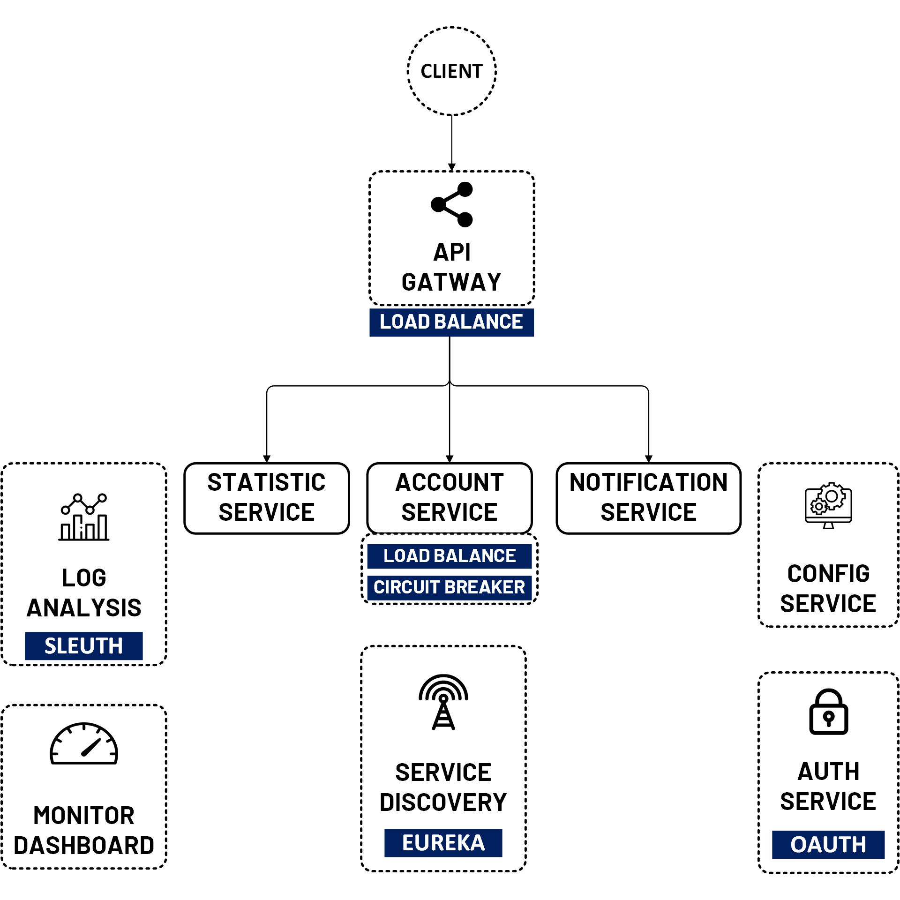
Create Account Service with Spring Boot
www.jmaster.io/course/microservices-with-spring-cloud

